Slide 1
MLB Ticket Sales by: The Red Team
Since we are in baseball season, we thought it would be interesting to test the biggest contributing factors to ticket sales!
In our presentation, we will :
1. Go over our initial hypotheses
2. Look at our analysis process
3. Review the conclusions the data showed us

Slide 2
What we are analyzing…
Attendance vs. Record
Attendance vs. Salary
Attendance vs. Weather
Attendance vs. Population

Slide 3
Hypotheses
The biggest correlation to ticket sales will be the team’s overall salary.
The smallest correlation to ticket sales will be city population.

Slide 4
Attendance vs. Record Analysis
by: Howard G. Mitchell III

Slide 5
The Process
Clean and combine the yearly attendance data with the stats data in order to create a uniform master DF to perform my visualizations.
Organize the cleaned data in an appropriate fashion to extract the story of Attendance vs. Record.
2a. Start with the overall set to get my correlations and a team agnostic scatter plot.
2b. Group the data be team to see the outliers.

Slide 6
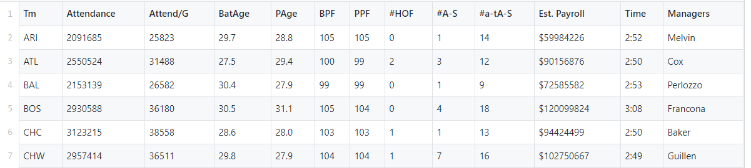
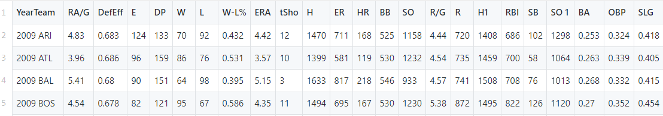
The Data

Slide 7
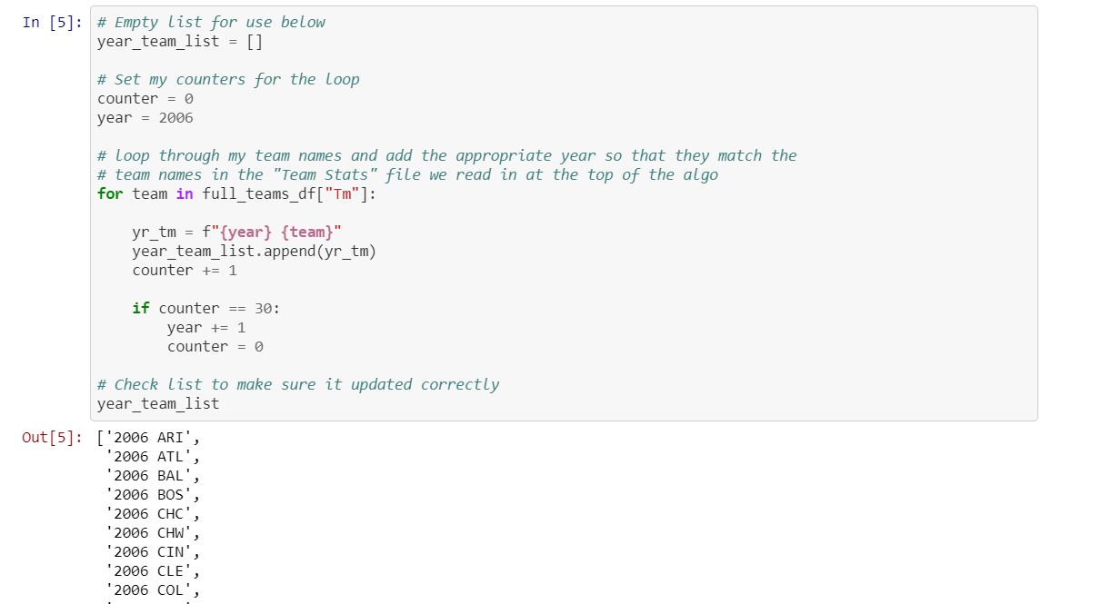
-Create new list to match the column formatting needed to properly merge the attendance and stats data sets together.

Slide 8
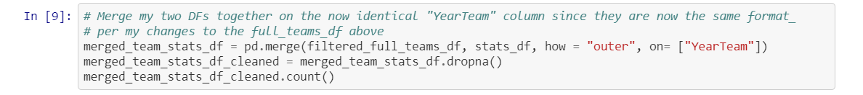
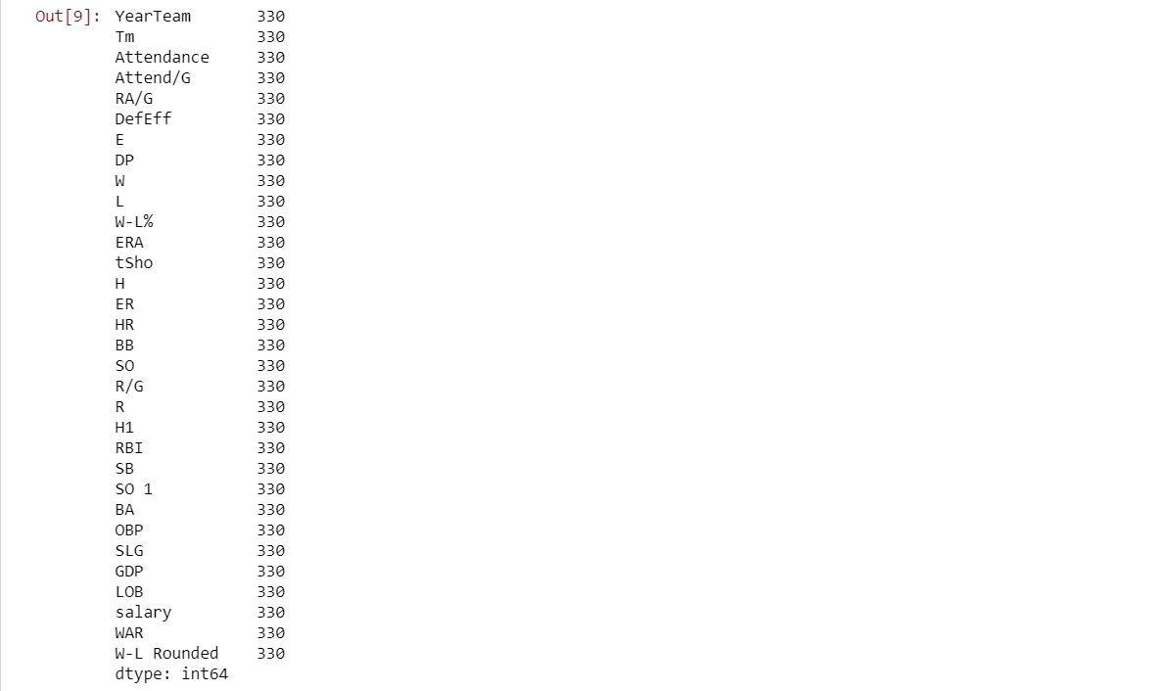
-Add the derivative list to the full teams(attendance) DF.
-Merge DFs on the homogenized “YearTeam” columns, drop all of the NA rows, and check my counts.

Slide 9
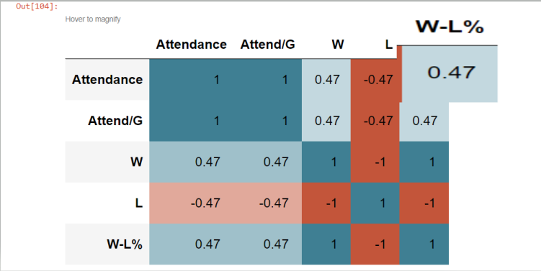
Correlation Matrix

Slide 10
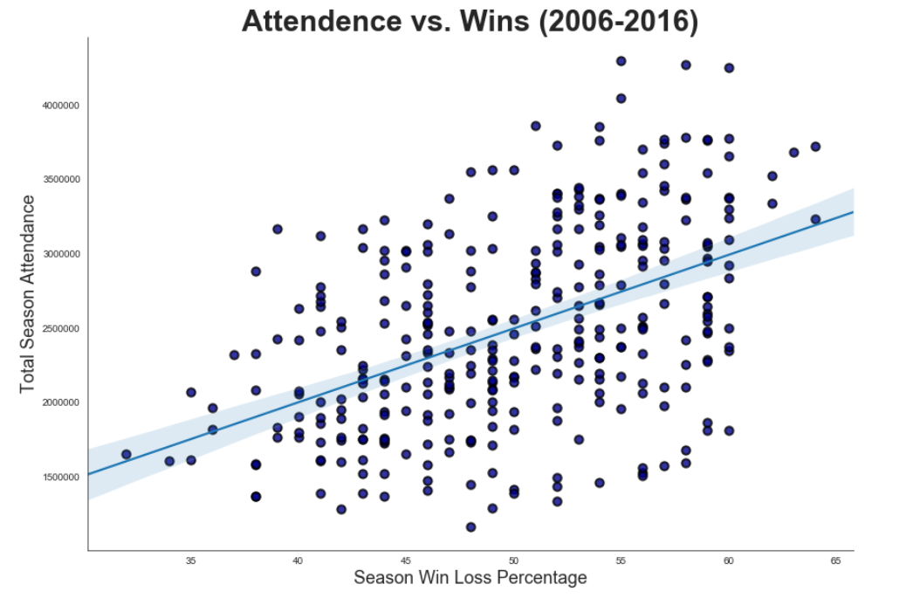

Slide 11
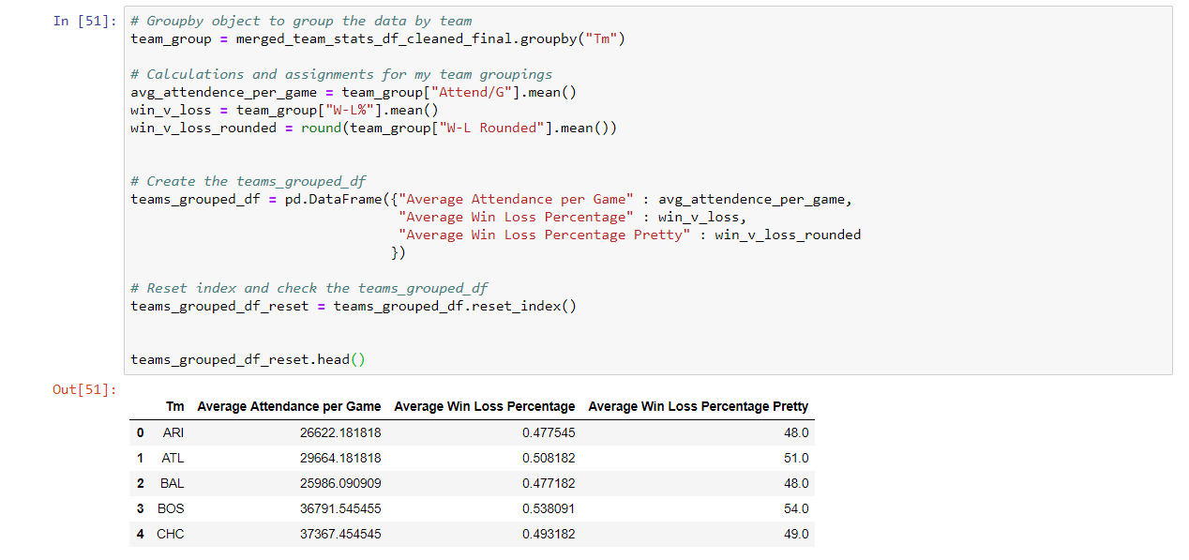
-Group data by team for team level visualizations.

Slide 12
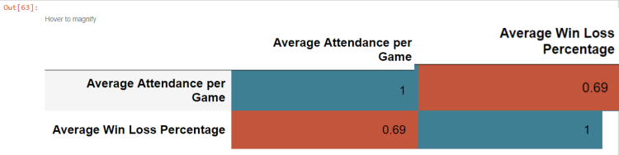
Team Level Correlation Matrix

Slide 13
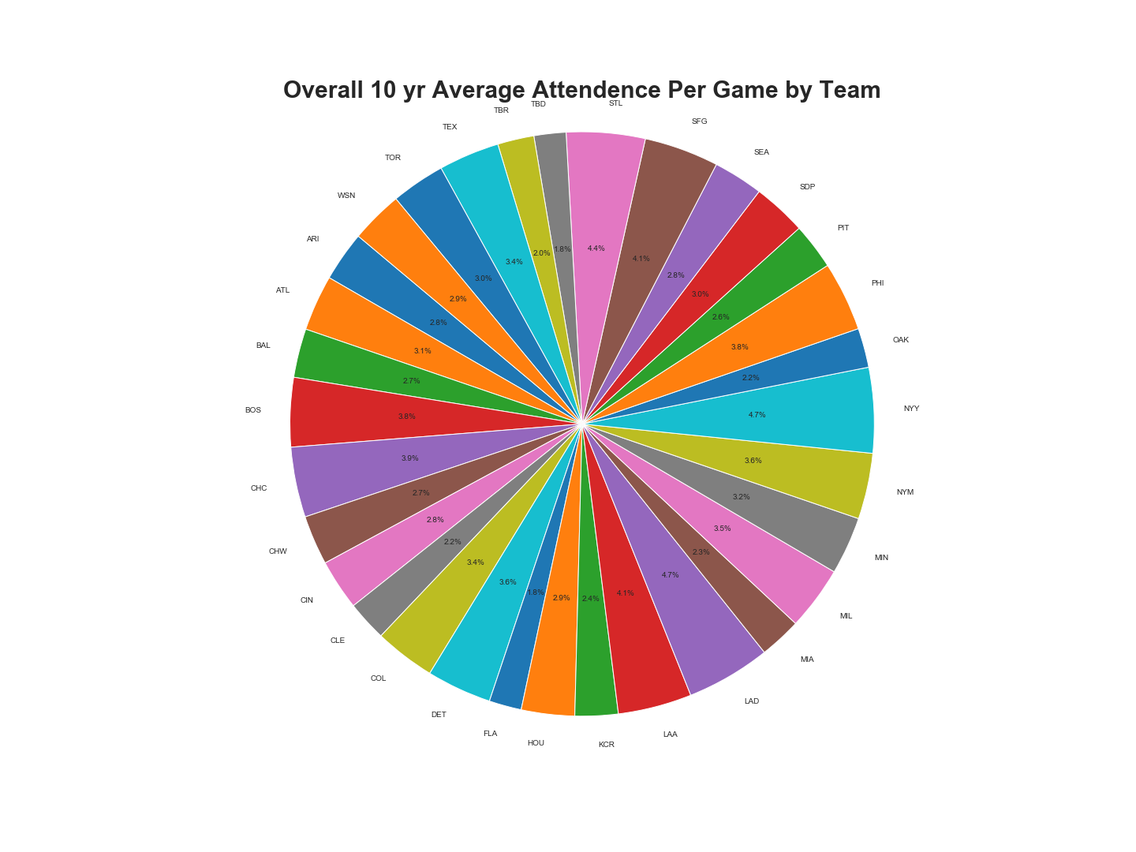

Slide 14
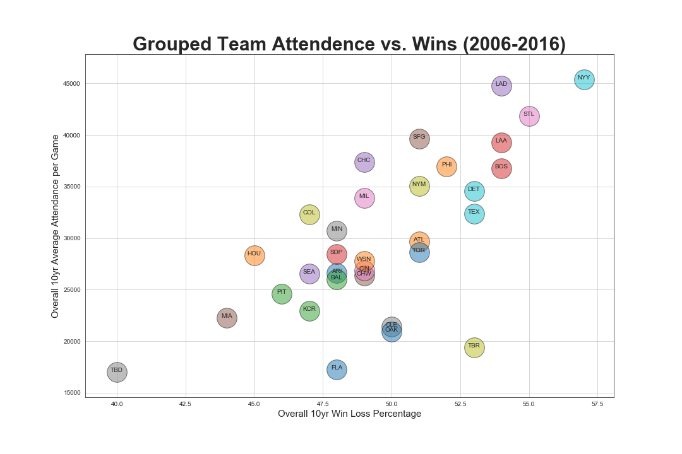

Slide 15
Team Record Conclusions
At a correlation of 0.47, there appears to be only a moderate correlation between win/ loss percentage and attendance.
With that said, the biggest outliers as far as highest winning percentages tend to have the highest number of attendees per game.
The New York Yankees have the highest average attendance per game at circa 45,384 attendees per game and the highest win percentage at circa 57% over the course of the 10 year period.

Slide 16
Considerations
Overall, even though we exhibit a moderate correlation of 0.47 for attendance vs. record, the data does not necessarily convey a overly strong and/ or causal relationship between the two factors.
One has to also account for the “bandwagon effect” where the better a team does over the course of the season, the more people might be interested in buying tickets and attending games.
There are teams with “any weather” fans, such as the Chicago Cubs, that do have an overall win percentage of less than 50% but still rank higher overall in the attendance metrics in comparison to the overall data set.

Slide 17
Attendance vs Payroll
What is the correlation between team salaries and ticket sales?

Slide 18
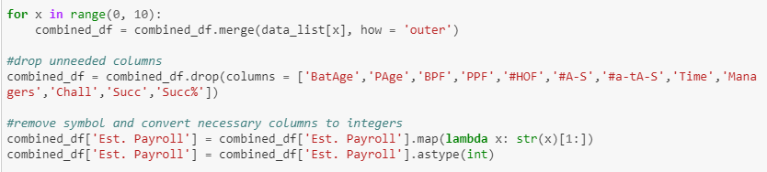
Data Cleaning Process
Merged data from 2006-2016
Removed incomplete and unnecessary data (four teams removed)
Cleaned and converted remaining data

Slide 19
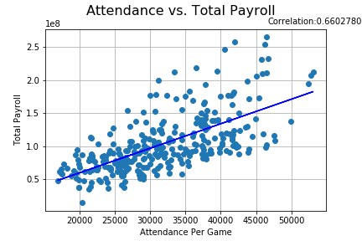

Slide 20
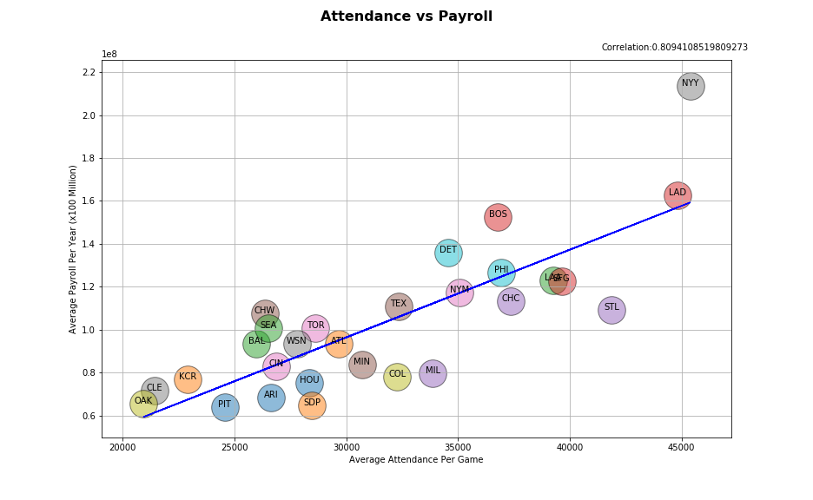

Slide 21
Conclusions
There is a strong (.81) correlation between team payroll and ticket sales.
This is probably telling us that teams which sell many tickets have more funds available to spend on payroll.
There are however some outliers. For example, the Yankees spent 2.14x what the average team spent during this period compared to the Cardinals who spend 1.09x the average, but the Cardinals sold 92% of the tickets that the Yankees sold during this period.

Slide 22
Considerations
Four teams were not used in this data set (FLA, MIA, TBR, and TBD) due to incomplete data across the ten year span

Slide 23
Attendance vs. Temperature
Is there a correlation between temperature and attendance per game?

Slide 24
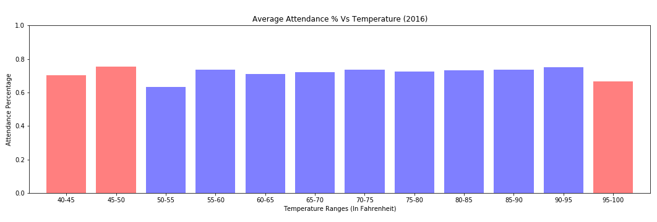

<30 data points
>30 data points
Why we used Attendance Percentage instead of Attendance
Binned the data every 5 degrees Fahrenheit
Removed games played in domes

Slide 25
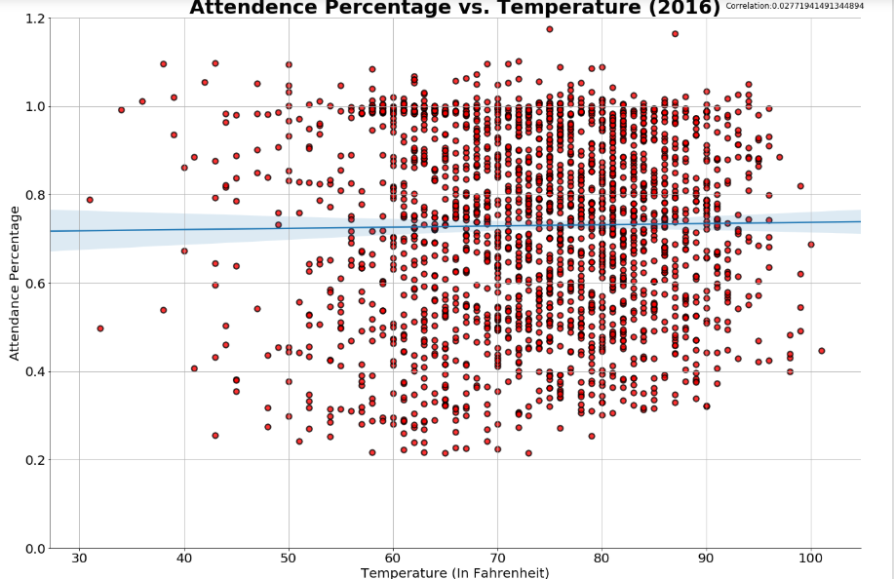

Slide 26
Weather Conclusions
The attendance data that we used did not contain the actual attendance at the game.
With a correlation of 0.0277, we conclude that there is no correlation between temperature and attendance (ticket sales).
Reasoning: Tickets are usually purchased weeks or months in advance.

Slide 27
Attendance per Game vs CSA Population
How strong is the correlation between population and attendance per game?

Slide 28
Considerations
We chose to use the Combined Statistical Areas defined by the Census Bureau because they tend to represent wider geographical areas than the Metropolitan Statistical Areas.
Four teams (MIA,TBR,ARI,SD) are not located with Combined Statistical Areas and Toronto is not located within the United States so we dropped these five teams from this analysis.

Slide 29
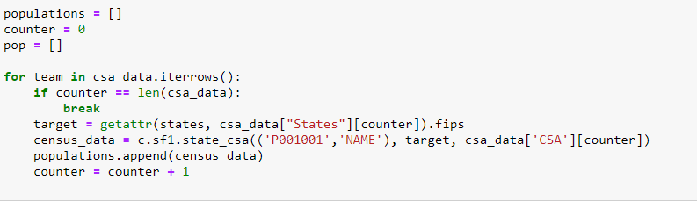
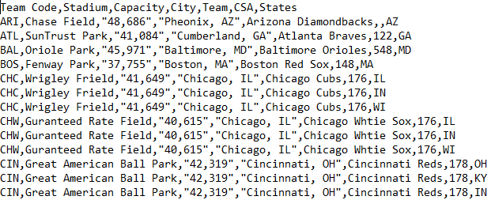
Using the Census Wrapper
The census frequently groups CSAs across state lines.
To collect the data for each state in each CSA we created a csv file to grab the data for each state and then used pandas to sum the population data for each team.

Slide 30
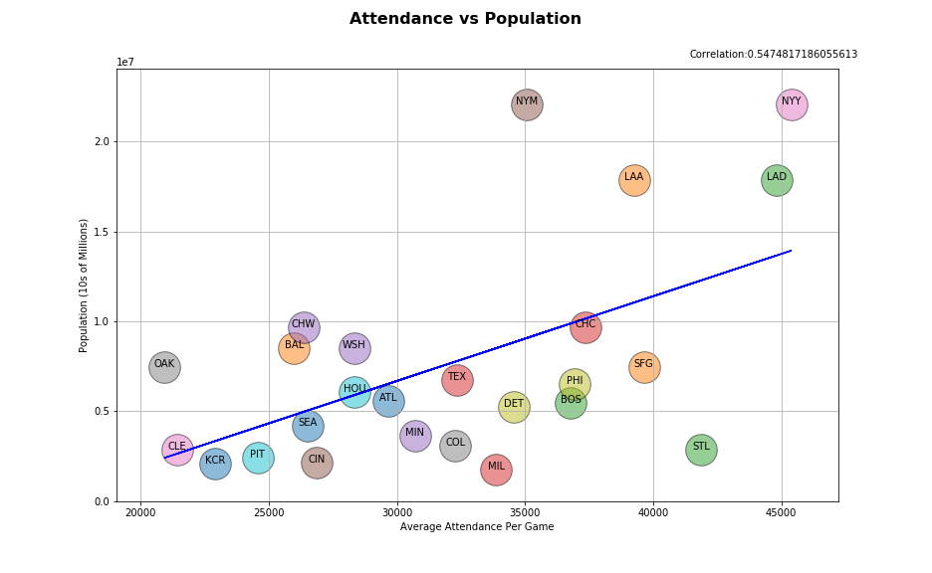

Slide 31
Population Conclusion
There is a moderate correlation (.547) between population and average team attendance however there are significant differences in attendance per game between the pairs of teams that exist within the same CSA.

Slide 32
Summary
Team Record: .69
Team Salary: .81
Weather: .02
Population: .54

Slide 33
Conclusions
We originally intended to look at some other factors such as concession prices but this data is apparently valuable enough that we would have had to pay for it.
Some of our results were surprising to us. For instance, we assumed that weather would have a substantial effect and it apparently does not. St Louis does better than we had expected relative to the population size and spending on payroll.
True attendance data is not made available by the MLB so while our sources called it “Attendance” we’ve really been discussing ticket sales.

Slide 34
Sources
https://www.baseball-reference.com/leagues/MLB/2006-misc.shtml
https://www.kaggle.com/cyaris/2016-mlb-season
https://www.kaggle.com/omipelcastre/mlb-team-statistics-20182003
2010 US Census Summary File 1 via census wrapper API
https://www.kaggle.com/arashnic/baseballdatabank

Slide 35
Questions?

